Slide 1
Welcome to AE403
Welcome to 2026 Spring semester at SDSU and to the AE403W class.
This class involves personal meetings and working/fabricating/testing in the lab. Usually, I list several options for the design projects and I’m also open to ideas from the students. Then we form groups of 2 to 4 students who work towards accomplishing the project objectives.
First, we need to form groups
Next, we try to decide on the project.
Here are some other remarks:
The AE department policy is to admit only 40 students to this course.
No ‘incomplete’ grade!
Safety training: a) exam, b) visit to the wind tunnel lab.
Writing content.

Slide 2
Course Number: AE403
Course Title: Aero Eng. Senior Project
Prerequisites by Topic: AE302, AE303, AE340
References (recommended reading):
Dym C I, “Engineering Design, A project based introduction,” John Wiley and Sons, 2004.
Ullman D, “The Mechnaical Design Process,” McGraw Hill, 1997.
Brandt S A, Stiles R J, Bertin J J, and Whitford R, “Introduction to Aeronautics: A Design Perspective,” AIAA Educational Series, 1997.
Topics covered:
1.Introduction: Experimental uncertainty and statistical errors
2. Project management, time tables, pert diagrams
3. Literature search project definition and initial planning
4. Measurement techniques and data acquisition
5. Manufacturing and Safety in laboratory
6. Experimental methods (load, pressure measurements, and flow viz.)
7. Design of proposed test
8. Conduct experiment
9. Analyze results
10. Write report and present results
Course Learning Outcomes:
An understanding of physics, chemistry and mathematics and how to apply this knowledge in the solution of engineering problems.
Design, build, and test an aerospace project.
An ability to design and conduct experiments, as well as to analyze and interpret data.
4. An ability to work on multi-disciplinary teams and to design complex systems such as aircraft or spacecraft, from a conceptual or preliminary design perspective.
5. Develop good oral, written and graphical communication skills (reports and presentations).
An ability to use the techniques, skills, and modern engineering tools necessary for engineering practice.
Safety in the lab – self exam + tour of labs

Slide 3
AE403 Project outline
1. Research of previous work (Literature survey)
a. What was done in the past?
b. What still can be done?
c. Select route for current work.
d. Recommend future work (that cannot be covered during this period).
2. Definition of Project
a. Examine several alternate (engineering) solutions
b. Select ‘most promising’ solution
c. Establish project time table (see attached Gantt chart)
3. Phase #1 of Project
a. Obtain materials, learn supporting computer codes, etc.
b. Prepare/fabricate hardware (e.g., wind tunnel model)
c. Develop test support (e.g, software)
4. Phase #2 of Project
a. Generate results (experimental/computational)
b. Analyze results
c. Based on analysis suggest improvement for immediate tests
d. If required, modify model/code
5. Conclusions and Report Preparation
a. Extensive data reduction
b. Graphs (nondimensional recommended) tables, etc.
c. Conclusions and future recommendations
d. Prepare written report
e. Prepare oral presentation

Slide 4
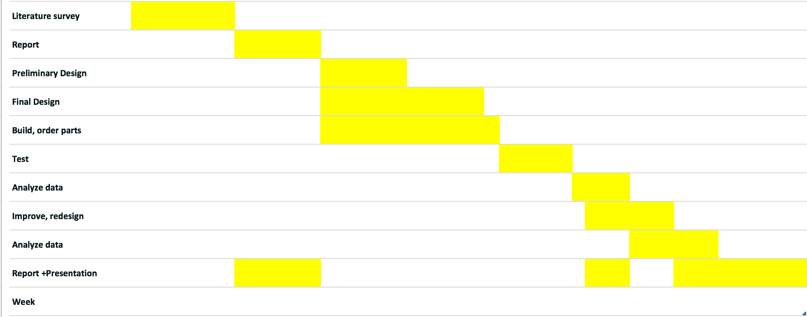
Gantt Chart
0. 1. 2. 3. 4. 5. 6. 7. 8. 9. 10. 11. 12. 13. 14. 15

Slide 5
Typical (Report) Structure
1. Introduction
a. Describe motivation for the project
b. What was done in the past? How the current work fills the void?
c. Recommendations for future work (that cannot be covered during this period).
d. Support statements by literature survey
2. Method (and describe the parameters investigated)
a. Detailed description of experimental setup, model, etc.
b. Description of computer codes if used
c. If some one reads this chapter ten years later – he must have sufficient information to duplicate the test and arrive at the same results!
3. Results
a. Present results, cross-plots, using easily recognized parameters
b. Use nondimensional parameters if possible
c. Effect of variables must be easily observed
5. Conclusions
a. Summarize most important conclusions
b. Explain how the initially set objectives were met
c. Recommendations for extending current work

Slide 6
Some Topics:
1) Buffeting (acoustics), Car mirror and antenna, acoustics
2) Drone mothership + glider
3) Helicopter in ground effect
4) Aerial marker vibration
5) DBF – support
6) Motorcycle aero or rear view
7) Flapping flight
8) High efficiency drone
9) VSTOL UAV
10) Tail sitter UAV (counter rotating + single rotor)
11) Supersonic gurney flap (also CFD)
12) Velocity of vortex ring
13) Propeller wing-tip vortex interaction
14) Ducted vs open propeller
15) Acoustic effects on airfoil
16) Parachutes
17) Quadcopter in forward flight + wing
18) Blown airfoil F-duct - to reduce lift
19) Kite with video and solar...
20) Drag of flags
21) Trapped vortex (low Re)
22) Wing tip devices
23) Smoke tunnel
24) 3D printed airplane competition
25) Drag of fence?
26) UAV MQ-9 Propellor Optimization (supported)
27) ME Race car project – rear wing design (sponsored)
28) 3D Printed aircraft (sponsored)
29) CA Unmanned Aerial System Competition (spons.)
30) Small Drone finding of Direction/orientation (spons.)
31) WIG (wing in ground effect)

